Slide 1
The Survey Process Toolkit
Division of Home and Community Based Services
Mildred P. Ferriter, Director, Division of Quality and Surveillance
Lori Novak – Program Manager, Capital District Regional Office

Slide 2
Objectives:
Discuss the purpose and process for the Licensed Home Care Services Agency (LHCSA) Re-licensure Survey
Identify the top 10 deficiencies cited for LHCSAs statewide

Slide 3
Survey Purpose
To evaluate LHCSA compliance with NYS regulations, ensuring that the provision of home care services meets minimum health and safety standards and a consistent level of quality
Assessing, monitoring, and evaluating the quality of care delivered by the agency using a patient centered approach

Slide 4
LHCSA Re-licensure Survey
Unannounced survey conducted triennially at the discretion of the Department
Review of all programs/services provided by the agency (including open complaints) and the systems in place to support those services.
Intended to assure the delivery of quality home care services and determine minimum compliance with applicable rules and regulations.

Slide 5
Survey Process- 6 Tasks
1. Pre-survey preparation
2. Entrance conference
3. Information gathering on-site
4. Information analysis/decision making
5. Exit conference
6. Formation of the Statement of Deficiencies

Slide 6
Pre-survey preparation
Notes:
Performed offsite prior to the agency onsite survey

Slide 7
Pre-Survey Preparation
Gather information about agency to assist in planning and organizing the survey so that it is focused, effective and efficient
Identify concerns and areas of focus to be addressed on survey
Identify regulation sets and Department policies to be evaluated during onsite review (10 NYCRR Parts 765, 766, 402, 403)

Slide 8
Pre-Survey Activities
Surveillance History
Complaint Finding and Trends
Health Commerce System Roles
CHRC Negative Determinations
Compliance with Required Reports
Licensure Information
Service and Program Approvals
Notes:
The survey team will conduct an offsite Review of:
Surveillance history- Previous survey findings/Plan of Correction
Complaints- open complaints and trends
Health Commerce System- Roles assigned, Home Care Worker Registry (aide rosters)
CHRC Negative Determination List Monthly Report
Compliance with required reports (Statistical Reports, Emergency Drills)
Licensure information- agency correspondences, service changes, operator, counties, address, etc.
Services/Program approvals (ALP, HHATP, Waiver-TBI, NHTD)

Slide 9
Entrance conference
Task 2

Slide 10
Entrance Conference
First stage of the onsite survey process
Surveyors introduce themselves and present ID
Survey team leader will inform the agency administrator, director or supervisor of the purpose of the survey and explain the survey process including:
compliance with state regulations and Department directives; and
determining the quality of care and services provided by agency
Notes:
We will also during the entrance conference, discuss the extent to which the agency staff may be involved in the survey
During the Entrance Conference, staff will:
Address issues or discrepancies identified during pre-survey activities
Identify key personnel, agency contact, and a clinical staff person to respond to surveyor’s questions
Request documents/information required for survey
Identify the clinical record documentation system
Request a place to work

Slide 11
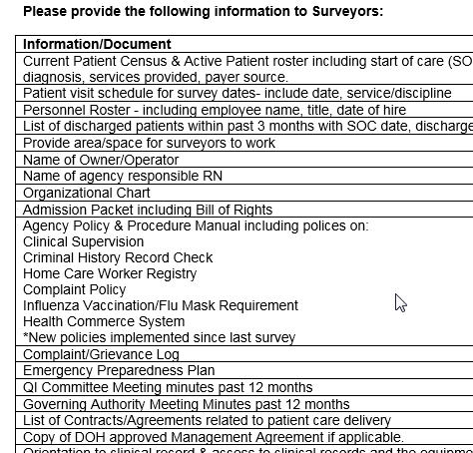
Survey Documents Requested
Agency’s response and cooperation in providing documents timely is key to facilitating an efficient survey process
Upon entrance please be prepared to provide:
Current Patient Roster
Employee Roster

Slide 12
Entrance Conference – Patient Roster
The surveyor will request:
Clinical Record and Home Visit Sample
Active patients receiving services
Patients discharged from services
Patients scheduled for home visits during survey time
Current patient roster

Slide 13
Information gathering
Task 3

Slide 14
Information Gathering
Organized systematic and consistent process used to inform decisions regarding the LHCSA’s compliance with Department policies and state regulations
Includes gathering information from home visits, observations, interviews, document review, clinical and personnel record reviews
Notes:
Task #3 or the information gathering phase of the survey occurs while the team is onsite.
Survey team is expected to administer activities using a Consistent process using established survey tools
Survey team members will review the following documents during this phase of the relicensure survey:
Agency admission packet and patient bill of rights
Agency policies for: Clinical supervision, CHRC, Home Care Worker Registry, Complaint, Influenza Vaccination/Flu Mask
Other new, pertinent, or revised policies since last survey
Agency complaint/grievance log
QI Committee meeting minutes past 12 months
Governing Authority minutes past 12 months
Contracts (sample selected from the agency’s list of contracts)
Emergency Preparedness Plan (compliance with DAL 16-11)
Clinical Records (sample)
Personnel Records (sample)

Slide 15
Program Reviews
Quality Improvement Program
Home Health Aide Training Program (HHATP)
Home Care Worker Registry
Notes:
During this review, surveyors will determine if there is evidence of an organized agency Quality Improvement (QI) program meaning is there documentation to support the following:
QI Committee? Members? Meetings 4 times/year?
Does QI Committee conduct required functions?
- Record reviews-active patients and discharges
- Review of complaints
- Review of agency policies and procedures
- QI report/communication with Governing Authority
For LHCSAS with a Home Health Aide Training Program we will use our tools to determine if:
There evidence that the LHCSA is conducting quality monitoring of the HHATP as required
Is there evidence of an annual HHATP evaluation report submitted to the sponsoring LHCSA’s governing authority
Home Care Worker Registry Review
Determines Compliance with 10 NYCRR Part 403
Policy addresses requirements?
Roles assigned on HCS related to Registry?
Are aides entered within 10 business days of hire?
Is registry updated within 10 days of aide’s termination?
Is registry aide listing consistent with agency’s employee roster?

Slide 16
Criminal History Record Check (CHRC) Review
Compliance with 10 NYCRR Part 402
Assigned roles on HCS related to CHRC
CHRC written policy that addresses all requirements:
consents;
timely requests;
supervision prior to final CHRC determination result;
negative determinations acted on; (immediately removed from patient care)
termination form submitted timely; and
confidentiality.
Agency has implemented and follows their written CHRC policy.
Notes:
Criminal History Record Checks are so important to ensure our patients are provided the safety needed to remain in their homes. I would ask that each of you review DHCBS 20-01 along with subsequent correspondence, and your agency policies and procedures. This is critical and failure to do so, has the potential to place patients at risk.

Slide 17
Clinical Record Review
Sample of active patients and at least one discharged patient
Determine compliance with Part 766 regulations including:
patient rights
assessment – initial and reassessment
plan of care
physician orders
clinical supervision- is care supervised? Services/care provided at frequency ordered, changes reported to MD, etc.
aide supervision, aide care plan, aide activity sheets
progress notes
discharge summary and MD notification at least 48 hours prior to discharge

Slide 18
Personnel Record Review
Sample of each type of active personnel: Professional & Paraprofessional
Verify compliance with HCR & CHRC requirements
Verify compliance with Personnel 766.11 requirements
Health status, immunizations, annual influenza vaccination status, credentials, application/reference checks, orientation, supervision, in-service requirements, annual performance evaluation including home visit, etc.
Notes:
Personnel qualifications, license and certification. health assessments, TB testing, immunizations, performance evaluations, orientation and training requirements,

Slide 19
Home Visits
Objective: Observation and evaluation of care provided
Patient interview
Staff Identification
Infection control standards
Compliance with the patient’s person-centered plan of care
Agency contact and complaints
Patient and Family satisfaction
Notes:
Does staff wear ID and follow infection control standards?
Are services rendered consistent with plan of care?
Does plan of care reflect patient’s current status?
Does patient know how to contact agency and how to lodge a complaint?
Is patient/family receiving services as ordered and is he/she satisfied with care and services provided?

Slide 20
Interviews
Interviews are conducted throughout the survey
Staff interviewed include the agency administrator, supervisors and agency staff
Objective is to gain a clear understanding of agency processes and communication with staff regarding policies, procedures, agency practices and workflow

Slide 21
Information analysis
Task 4

Slide 22
Information Analysis/Decision Making
Objectives:
Informs compliance decisions
Allows for thoughtful review and analysis of information gathered during the survey process
Determines the presence of isolated, patterned or systemic non-compliance
Notes:
Allows surveyors to make decisions concerning an agency’s compliance with regulatory requirements.
Surveyors review and analyze all information collected (including completed survey tools/worksheets)
Surveyors determine whether or not the agency has failed to meet any regulatory requirements.

Slide 23
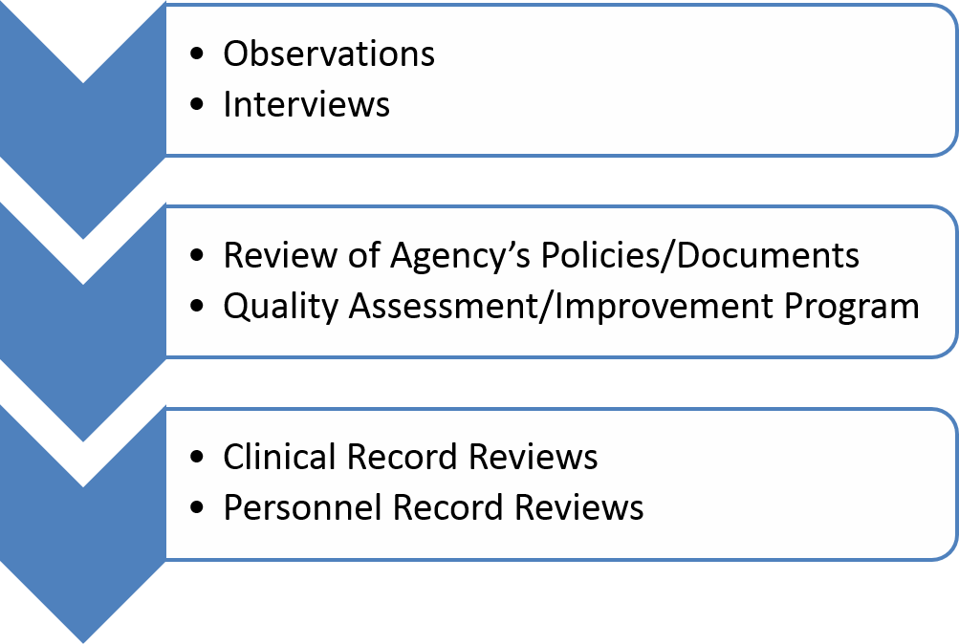
Information Analysis

Slide 24
Exit conference
Task 5

Slide 25
Exit Conference
Communicate to the agency of observations and preliminary survey findings
Held at conclusion of onsite survey with agency administrator, clinical supervisors and/or other invited agency staff
Provides details and timing on next steps including Statement of Deficiencies and Plan of Correction
Notes:
Provides an opportunity to Communicate to the agency of observations and preliminary survey findings in order to facilitate the agency’s understanding of possible deficiencies.
Held at conclusion of onsite survey with agency administrator, clinical supervisors and/or other invited agency staff.
Discuss the issuance of the SOD report electronically through the Health Commerce System (ePOC application) and time frame for the agency to submit the electronic Plan of Correction (POC) .
The POC must be submitted through the ePOC application within 10 calendar days of receipt of the SOD.

Slide 26
Statement of Deficiencies (SOD)
Provides a written report of areas of non-compliance with State requirements
Issued through the Electronic Plan of Correction (ePOC) application on Health Commerce System (DAL DHCBS 15-04)
Requires update to date Health Commerce System(HCS) role assignments
Requires written response within 10 days
Notes:
Provides a written report of areas of agency operation that fail to meet minimum standards as established by State requirements
Issued electronically through the ePOC application on Health Commerce System (DAL DHCBS 15-04)
Health Commerce System(HCS) roles- Administrator and Director of Patient Services receive SOD posting notification
HCS roles can read SOD: Administrator, DPS, HCS Coordinator, ePOC editor, Governing Body Chair or Member

Slide 27
Components of Acceptable Plan of Correction(POC)
Corrective action (s) to be accomplished for those patients affected by the deficient practice
Method of identifying other patients having the potential to be affected by the same deficient practice and what corrective action (s) will be taken
Measures needed to address systemic changes the agency will implement to ensure sustainability of corrections
How the corrective action(s) will be monitored
Target date for the correction and title of person (s) responsible for the correction of each deficiency.
Notes:
The plan of correction is the agency’s plan of corrective actions to be taken to bring the agency into compliance for each deficiency cited. The agency will document the plan of correction on the Statement of Deficiencies and Plan of Correction, DOH-1053, and return it to the area office within 10 days of receipt of the statement of deficiencies. When the plan of correction is received in the area office, the surveyor reviews it to determine its acceptability. An acceptable plan of correction will include: • Steps to be taken to correct the cited deficiency; • Steps to be taken to prevent future occurrence of a cited deficiency; • Person(s), identified by position, responsible for the correction; Licensed Home Care Services Agencies Surveillance Process 15 • Anticipated completion date for achieving correction of each deficiency
Cover letter defines the required components of an acceptable POC:
Corrective action (s) to be completed for each deficiency
How will agency identify other patients who might be affected by same deficient practice &
what will agency do to correct?
Changes to system to prevent recurrence of deficient practice
Monitoring of corrective action
Date for correction, & title of person responsible for each correction
Agency must submit ePOC through the Health Commerce System within 10 days of receipt of the Statement of Deficiencies
HCS roles can write POC: Administrator, DPS, HCS Coordinator, ePOC Editor
HCS role can submit POC: Administrator

Slide 28
Reminder: Changes in Service(s) or Location
Compliance with 10 NYCRR 765-2.2
To add a service(s)- written request and DOH approval required
To discontinue a service- DOH notification at least 30 days prior to effecting change
Change in address/office location – Requires notification to DOH at least 10 days prior to effectuating change

Slide 29
DOH Regional Offices
MARO-New York City | MARO-New Rochelle | MARO-Central Islip | Capital District | Central New York | Western | Western-Rochester
New York City Office 90 Church Street - 14th Fl Between Barclay and Vesey Streets New York, NY 10007-2919 (212) 417-5550 | New Rochelle Office 145 Huguenot Street, 6th floor New Rochelle, NY 10801-5291 (914) 654-7007 | Central Islip Office Court House Corporate Center 320 Carlton Avenue Suite 500-5th Fl Central Islip, NY 11722 (631) 851-4300 | Capital District Office 875 Central Ave Albany, NY 12206-1309 (518) 408-5287 | Central New York Regional Office 217 South Salina Street Syracuse, NY 13202-1380 (315) 477-8472 | Buffalo Office Ellicott Building 295 Main Street, Suite 300 Buffalo, NY 14203 (716) 847-4302 | Rochester Office Eagle’s Landing 1565 Jefferson Road, Suite 120 Rochester, NY 14623 (585) 423-8100

Slide 30
Program Specific Email Contacts
Home Care: homecare@health.ny.gov
Home Care Licensure and
Certification: homecareliccert@health.ny.gov
Home Care Registry: hcreg@health.ny.gov
HHA Training Programs: hhatp@health.ny.gov
PCA Training Programs: pcatp@health.ny.gov

