Slide 1
St. Ann’s Continuous Performance Management

Slide 2
The “Old Way”
Annual Performance Evaluation
Graphic Rating Scale – Performance is ranked on a continuum from low to high on each individual category or characteristic
  Behavioral expectations
  Specific job competencies
Narrative – Descriptive text of employee’s strengths/accomplishments and opportunities for growth/development
Performance evaluation singularly and directly tied to annual merit increase

Slide 3
Graphic Rating Scale
Highest - This person ranks in the top 10% of the work group or organization for this category.
This person’s performance in this category is better than average for the department based on common standards.
This person performs in this category at the same level as most experienced and competent employees.
This person’s performance in this category is slightly below the minimum standards, but has potential to improve within a reasonable timeframe.
Lowest - This person’s performance in this category is inconsistent or unacceptable. It is questionable whether or not this person will be able to perform in this category at an acceptable level.

Slide 4
Flaws of the “Old Way”
Varying Standards | Unclear standards from manager to manager
Recency/Primacy | Giving greater weight to recent events or events which occurred first
Central Tendency/Leniency/Stringency | Average/Overrated/Underrated ratings in all categories
Rater Bias | Rater’s values or prejudices distort rating
Halo/Horns Effect | Overall impression not based on specific objectives causes over or under rating
Fives or Bust | Person being rated believes they should be rated highest score on each competency
Similar-to-Me/Different-from-Me | Rater influenced by characteristics the same as/different from their own
Sampling Error | Rater has only seen a small sample of person’s work

Slide 5
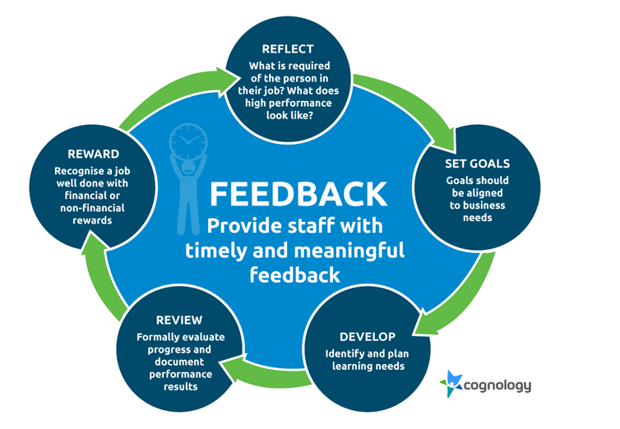
What is the purpose of providing feedback to team members?

Slide 6
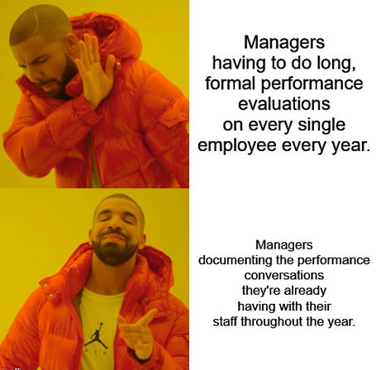

Slide 7
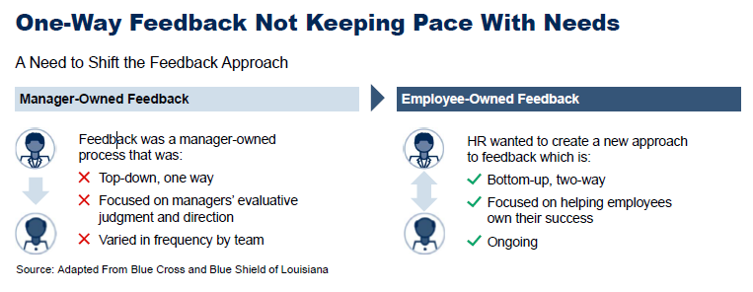

Slide 8
The “New Way”
Care Partner Conversations
3 annual performance conversations with each team member
15-20 minute one-on-one meetings
Measures team member’s alignment with mission, vision, values of organization & team
Provide timely feedback about employee performance
Help remove barriers in the workplace

Slide 9
Benefits of Care Partner Conversations
Expectations are made clear
Management is quickly made aware of any issues
Strengthens trust between manager and team members **Identified as primary engagement survey opportunity
Team members feel a sense of purpose identifying with organizational goals

Slide 10
Care Partner Conversation Topics
Follow up on items from previous Care Partner Conversation
Our organizational goal this year is to stabilize our workforce. How do you help contribute to this in your role?
As your manager, what can I do to help you focus on the important work that you do here? What can I do to help you remove barriers?
One item of praise, one item of coaching
Explain follow up – what employee needs to do and what manager needs to do

Slide 11
One item of praise, one item of coaching
Praise for a job well done
  A job task/skill they possess that they do exceptionally well
  A behavior they possess which they can role model for others
  A significant improvement they have made since you last met
A coaching opportunity
  A job task/skill they could improve on
  A behavior or policy compliance which does not meet your expectations
  Provide guidance on how to improve

Slide 12
Make it a two-way conversation!
Be open to feedback about yourself/your management style
Remove distractions
Take notes
Reply with purpose (paraphrase to make sure you understand what team member intended)
Prepare to answer open ended questions
Share ownership
Allow space for reactions
Offer suggestions

Slide 13
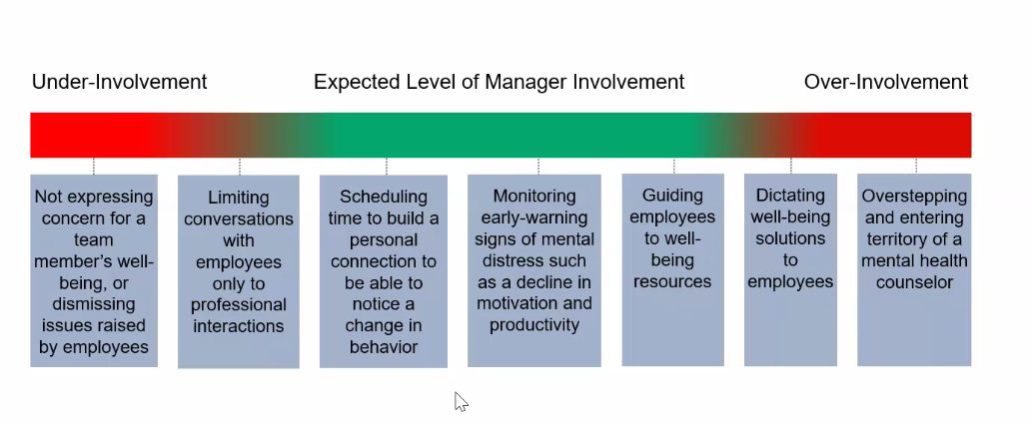
Building Appropriate Manager/Team Member Relationships

