Slide 1
EQUAL: Enhancing the Quality of Adult Living
Division of Adult Care Facility and Assisted Living Surveillance
Notes:
Welcome. My name is ……………………….and I am (title, etc, DOH)
Today’s presentation is designed to provide an overview of the Adult Care Facility Enhancing the Quality of Adult Living Program known as EQUAL.
We will provide information regarding
the intent of equal, including the types of funding available and approvable expenses
The funding methodology and distribution; and
The application process.

Slide 2
Purpose:
What is EQUAL?
Notes:
EQUAL is a budgetary appropriation for Operators of Adult Homes or Enriched Housing Programs who provide services to individuals receiving Supplemental Security Income (SSI), State Supplemental Program benefits (SSP), Safety Net assistance (SN, and/or Medicaid (with respect to those residents in Assisted Living Programs). The intent of the funding is to enhance the quality of care and life experience for those residents.

Slide 3
What type of funding is EQUAL?
The EQUAL appropriation is comprised of two types of funding:
Local Assistance Funding – Local Assistance Projects will be available to support improvements to the quality of life for adult care facility residents by funding projects including clothing allowances, resident training to support independent living skills, improvements in food quality, outdoor leisure projects, and cultural, recreational and other leisure events.
Capital Improvement Funding - Capital Improvement Project funds will be available to support the enhancement of the physical environment of the facility and promote a higher quality of life for residents.
Notes:
EQUAL funding is provided to enhance the quality of care and life experience for eligible residents.
The appropriation is comprised of two types of funding that can used to expand or enhance services and/or the facility’s physical environment.
Local Assistance is generally monies used for direct benefit to the individual. For example, clothing allowances, resident training for independent living skills, improvements to food quality (such as guest chefs or special dining events)
While Capital Improvement Funding is used to enhance the environment. Capital Improvement is generally used for those projects that are structural in nature including but not limited to:
Fixing a defect or design flaw (not required by Reg or to ensure the safety and wellbeing of residents)
Creating an addition, physical enlargement or expansion to resident areas
Improving or Expanding a major component or structural part of the property for resident use
Remodeling for aesthetic purposes or to adapt existing space for a different purposes (not required by Reg or to maintain resident safety and well-being)
Built-in appliances (for resident use)
But may include enhancements to the environment including furniture (for resident specific furniture, it must be an upgrade).
In general, if the facility owns it, it’s capital improvement while if the resident owns it is local assistance HOWEVER there are nuances. We encourage facilities to contact us before submission if they have questions.
EQUAL is not a cash award for residents and must be used to enhance the quality of life and life experience of residents as measured by the expenses incurred.

Slide 4
What can EQUAL be used for?
Local Assistance | Capital Improvement
Clothing allowances, monthly gift baskets, shopping trips, bedding upgrades. | Aesthetic facility upgrades (painting, carpeting, artwork, improvements to landscaping, furniture including, but not limited to, upgrades in resident room furnishings).
Computers, Televisions and/or iPads purchased for specific (eligible) residents. | Computers, Televisions and iPads in resident common areas or purchased for shared use.
Improvements in food quality (featured menus or culinary events, small appliances [e.g., steamers, blenders]) | Built-in appliances for resident use
Outdoor leisure projects (supplies for outdoor events/activities, etc.) | Outdoor leisure space (building/installing and furnishing patios, community gardens, gazebos, etc.).
Staff training, outside of those that are regulatorily required (i.e., cultural or sensitivity training) | Air conditioning (in resident areas).
Transportation for resident services/events (gas, tolls, third party payment such as chartered buses, taxis, or limousines) | Enhancement or Expansion of Resident Areas (this may include construction)
Cultural, recreational or other leisure events.
Notes:
This slide outlines some of the approvable expenses, by funding line.
Examples of approvable Local Assistance expenses include:
Clothing allowances, the facility must have reasonable assurance that the monies are used for the purchase of clothing some examples include
Purchase of a gift card to the clothing store identified by the specific resident (each resident has choice)
Coordinating a day of shopping either outside of the facility or by bringing vendors in
Gift cards that cannot be used for the purchase of alcohol, tobacco and fire-arms.
This is not a reflection of residents but ensures that Department of Health/State funding is not used to support in this capacity
Examples of outdoor leisure projects – mats for outdoor yoga, gardening tools and supplies for a gardening club, including resident-built garden bed kits (part of the activity, outdoor games (badminton, bocce, etc.)
Events – concerts, BBQs, parties, arts & crafts
Examples of approvable Capital Improvements include:
Portable and stationary air conditioning. HVAC upgrades to the facility.
Shared electronics
Kitchens and built-in appliances for resident use vs. Facility required kitchen/appliances
Outdoor leisure space includes building, installing and furnishing (patios, gardens, Gazebos – pop up or built in)
Construction

Slide 5
What would be inappropriate for EQUAL funding?
Legal or Regulatory Obligations CANNOT be funded with EQUAL awards
Regulatorily required staff training
Staff salaries
Bedroom furniture required pursuant to Regulation
EQUAL Funding CANNOT supplant the obligations of the facility Operator to provide a safe, comfortable living environment for residents in a good state of repair and sanitation
Creation or renovation of resident restricted spaces (i.e., staff offices)
Repaving broken walkways, replacing broken windows
Routine maintenance/repairs or such repairs needed to ensure resident safety
Notes:
Funding cannot be used to supplant the facility’s legal or regulatory requirements; nor can funding be used to supplant the obligations of the facility operator to provide a safe, comfortable living environment
Examples include: Staff Training Required by Regulation; Staff Salaries; Bedroom furniture required by Reg; creating or renovating resident restricted space (staff offices); repaving broken walkways or windows; regular maintenance or repairs required to ensure resident safety.
The Department reserves the right to deny funding for any expenditure that does not support the health and well-being of community members (i.e., tobacco, alcohol, firearms, etc.).
Neither the allowable expenses slide nor this slide are meant to be exhaustive lists – the Department will review all proposals for the acceptable use of program funds with final approval residing with the Department. We just hope this will help to provide clarity that will be helpful as you develop your proposed spending plans.

Slide 6
How are EQUAL awards determined?
Notes:
So how do we determine your EQUAL award? (next slide)

Slide 7
Application Submission
Application Review
Funding Methodology
Facilities must submit ALL required components of the application in the manner and by the deadline provided.
Department staff review to determine:
Eligibility; and
The application is complete and timely.
A per person amount, based on eligible residents reported on 2nd Quarter QSIR. An additional allotment for facilities ≤100 beds.
Notes:
Upon receipt of submissions, Department staff will review to determine whether the facility is eligible for funding. This could include but not be limited to:
Complete Application
It is the facilities responsibility to ensure that all deadlines are met and all required components of the application are provided. Any facility that has not fully complied with the Application Instructions will be deemed non-responsive. As such, the application will not be reviewed. Applicants must review the application instructions and ensure that all required components of the application are completed and submitted.
Timely Submission
Complete applications that do not meet the application deadline will be deemed non-responsive. As such, the application will not be reviewed.
Accurate Submissions
It is extremely important that applications are reviewed for accuracy as determinations will be made based on the submissions as they are received. For example, a facility’s intent to close precludes them from funding. While facilities intending to close should not apply; all applicants must include a statement regarding intent of closure in the application. If a facility identifies, in their application, an intent to close, they will be deemed ineligible for funding.
Previous EQUAL Spending Compliance
Failure to submit the required and/or any requested documentation for previous EQUAL funding may deem the facility ineligible for future funding opportunities.
Enforcement history
The Department may deny any operator that has received official written notice from the Department of a proposed revocation, suspension, limitation or denial of the operator's operating certificate; or proposed assessment of civil penalties; issuance of a Department order, the seeking of equitable relief or the issuance of a Commissioner’s Order.
A SFS Vendor ID Number is a required application component. Failure to include the correct SFS Vendor ID Number will result in non-award.
The Department may, at any time, reassess the continued eligibility of an operator to receive an EQUAL payment by failing to meet compliance standards on an ongoing basis.
Funding
Facility awards are calculated on a per-person amount based on the numbers of SSI, SSP, SN, and/or Medicaid (with respect to ALPs) beneficiaries residing in the facility as reported to the Department by the facility via the second quarter 2021 Quarterly Statistical Information Report. An additional funding allotment will be provided to facilities with a capacity of 100 beds and under.

Slide 8
EQUAL Application Components
Notes:
The EQUAL Application will be completed in HCS. There are NO requirements to submit documents separately via email. The application components include (next slide)

Slide 9
EQUAL Application Required Components
Section A: Acknowledgement of Participation
Section B: Facility Information
Section C: Payment Information
Section D: Population Served
Provide data on residents currently receiving SSI, SSP, SN support and/or Medicaid (with respect to residents of assisted living programs). Those residents receiving a combination of services must only be counted once.
Section E: Certifications and Confirmations
The Facility must provide information, confirmation and certifications regarding:
Previous EQUAL funding;
Resident involvement in the development and approval of the proposed Spending Plan, and
Certification of proper use of EQUAL funding.
Confirmation of submission of necessary attachments is also required.
Proposed Spending Plans are NOT a part of the Application but are required
for funding.
Notes:
Sections A – E are all required and, as previously mentioned, part of the HCS Application.
Please note, proposed spending plans are NOT a requirement of the application.
Upon close of the application, an Eligibility Review will be conducted to identify those facilities that are eligible for funding.

Slide 10
EQUAL Application Eligibility Review
Criteria | TRUE Proposal Meets Criteria | FALSE Proposal Does Not Meet Criteria
The application is complete. | ☐ | ☐
The facility is not on the Do Not Refer List. | ☐ | ☐
The operator or facility is not on the OMIG exclusion list. | ☐ | ☐
The facility has no unanswered or unacceptable plans of correction related to past EQUAL grants. | ☐ | ☐
The application does not indicate the facility intends to close this calendar year. | ☐ | ☐
The applicant has SSI/SSP/SN or Medicaid (ALP) residents. | ☐ | ☐
Notes:
During the Eligibility Review we will assess:
Whether the application is complete
If the facility is on the Do Not Refer List;
If the Facility is on the Office of the Medicaid Inspector General’s Exclusion List;
Whether there are any open EPOCS related to past EQUAL grants
If the facility indicated an intent to close
The SSI/SSP/SN or Medicaid (ALP) resident census.
If the application meets any of the criteria outlined in items 1 – 5 above or does not have eligible residents as demonstrated by the SSI/SSP/SN or Medicaid (ALP) resident census, the facility will be deemed ineligible for funding.

Slide 11
What are the EQUAL Process Steps?
Application Completion and Submission
Eligibility Review
Review of Applications
Intent to Award Letters and Letters of Ineligibility Issued
Proposed Spending Plan Submission
Spending Plan Review and Negotiation
Spending Plan Approval Letters and Letters of Ineligibility due to Non-Response Issued.
Notice of Submission of NYSE CON applications, if applicable.
Award Letters Issued.
Public Posting
12 months from date of DOH payment to spend.
Notes:
The Application and Completion Phase of EQUAL includes:
Opening the Application on HCS
A Question and Answers period: This allows facilities to submit questions, in writing, to equal@health.ny.gov. All questions will be reviewed, and an FAQ released.
Application Closes – Applications are Due.
Upon close of the Application, the Department will complete the Eligibility And Application Review and issue either Intent to Award or Letters of Ineligibility.
Receipt of an Intent to Award Letter does not guarantee payment. Facilities must submit proposed spending plans, with resident approval, by the deadline issued or they will be deemed ineligible, and they will not be funded.
DOH will post all final equal awards, including facility name, award amount and approved spending plan.
Timeline 2023-2024
Notice of Application Issued with EQUAL 101 Webinar mm/dd/yyyy
EQUAL Questions Due
Q&A Issued
Applications Due:
Application Review Completed:
Intent to Award Letters Issued:
Non-Awardee Letters Issued:
Proposed Spending Plans Due:
Spending Plans Approved and Letters Issued:
Notices of NYSE CON Submission Due:
Award Letters Issued:
Payment Made/Awards Publicly Posted:
Exhibits A and B Due

Slide 12
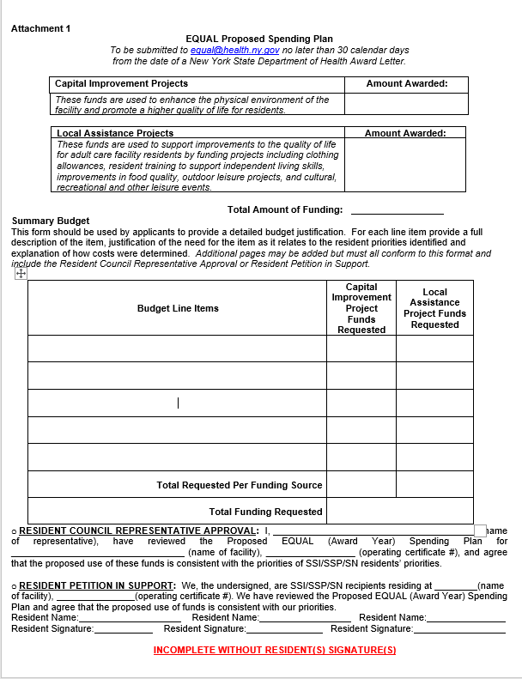
Spending Plan Submission
Notes:
*
Assurance that the SSI, SSP, SN or Medicaid (as it pertains to ALPs) residents were consulted and agree with the expenditures outlined in the facility proposal;
a Resident Council Resident Approval or Resident Petition in Support section to be signed upon completion of the Summary Budget.
We are no longer requesting the resident’s top three priorities but are requiring sign-off on the entire proposed budget.
All proposed Spending Plans are subject to Department Review and Approval. An approved plan must be in place before the Department will issue an EQUAL Award payment.
The Amount Awarded Section must match the amount in the facility’s Intent to Award Letter and the Summary budget must not exceed those amounts. If additional pages are needed, the Resident Council Representative Approval or Resident Petition in Support must also be completed.
Formal notice of an approved spending plan will be issued by the Department. An approved EQUAL Spending Plan does not authorize facilities to move forward with projects that otherwise require Department approval. Facilities must ensure compliance with all applicable State or Department issued guidance and secure all required approvals prior to utilizing EQUAL funds, or such funds may be subject to recoupment.
Upon receipt of an approved spending plan, facilities proposing to utilize EQUAL funding for Capital Improvement projects that require Department approval have an additional sixty (60) days to submit a complete application, with a copy of the approved spending plan, through NYSE-CON. EQUAL funding cannot be used to support any part or portion of an application until formal Department approval to commence has been provided.

Slide 13
Capital Improvement NYSECON Applications
18 NYCRR § 485.5(f) “No operator shall change or modify a facility, or the services originally approved and stipulated by the operating certificate, without the prior written approval of the [Department of Health]…”
18 NYCRR § 487.11(b) requires plans and specification for construction, renovation, or addition be submitted to the Department of Health (“Department”) and only upon receipt of written approval from the Department shall any portion of the plans be implemented.
DAL #21-22 Resident Safety Plan submissions to perform construction, repair, renovation or addition to an adult care facility must be uploaded through the New York State Electronic Certificate of Need (NYSECON) system in the Health Commerce System.
Notes:
Insert Slide

Slide 14
Construction/Renovation Beyond Routine Maintenance
What is “routine maintenance”?
Maintenance or testing of fire alarm system
Power washing shutters
Replacing a smoke detector
Replacing a part to a mechanical system
Cosmetic maintenance (minor painting)
Ceiling tile replacement
Carpet cleaning
Cleaning out a septic tank
Source: DAL# 21-22 attachment_1

Slide 15
EQUAL Expenditures & Required Documentation
Notes:
Operators in receipt of their EQUAL Award funding, must immediately begin spending as outlined in their approved spending plan and in accordance with other Department approvals. Local Assistance monies awarded for the purchase of items of immediate resident benefit should be made as soon as funding becomes available. Operators must expend their full award within twelve (12) months of the date of payment..

Slide 16
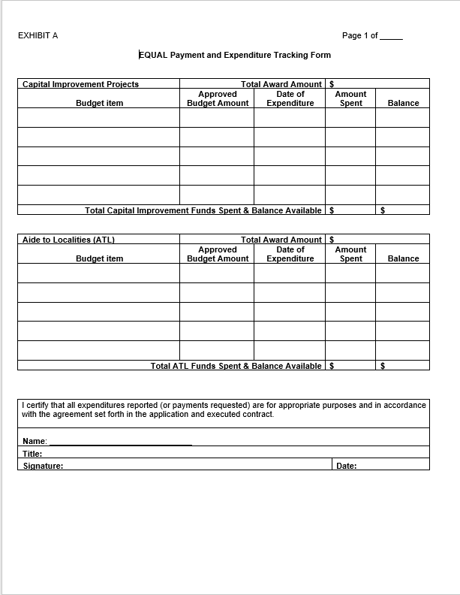
Notes:
EXHIBIT A of the EQUAL Instructions is the Payment and Expenditure Tracking form. This form was also required for the 2020-2021 funding period.
Facilities must
1. complete this form as expenses are incurred;
2. maintained on file by the facility along with supporting receipts and the approved spending plan), and
3. Present the form to the Department upon request (this could include, but not be limited to, a written or verbal request from the RO or CO, or upon survey). Surveyors will be notified that this is the official record of EQUAL expenses and will be expecting to see this document with proof of expenditure.
A completed form will include:
1. The total award amounts for reach funding category (Capital Improvement and Local Assistance);
2. All approved budget items and amounts per the approved spending plan;
3. The date of expenditure, amount spent and remaining balance (to be completed as expenditures are made); and
4. The Total funds spent, and balance available sections should be updated accordingly.
As purchases are made, the certification section must be completed to reflect that all expenditures are in accordance with the approved plan.
Upon disbursement of all EQUAL funding, and no less then 12 months from the date of award, Exhibit A and Exhibit B must be submitted to the Department.

Slide 17
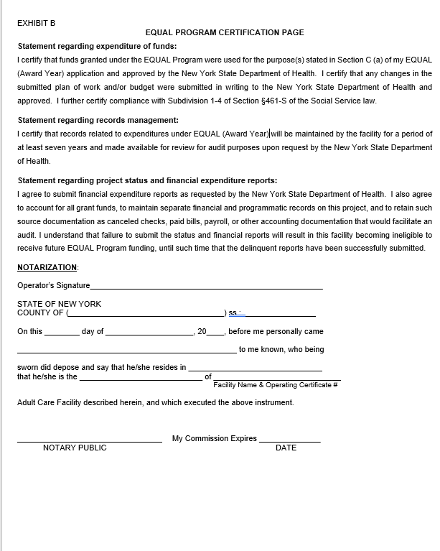
Notes:
Exhibit B is the EQUAL Program Certification Page. This has been required in previous EQUAL award years and is used to certify that EQUAL Program funds were used for the intended purposes, that records will be maintained for a period of at least seven years, and that the facility agrees to submit financial expenditure reports as requested by the Department, to account for all grant funds, maintain separate financial and programmatic records, and to retain documentation such as cancelled checks, paid bills and other accounting documentation.
Failure to submit Exhibit A and B may deem the facility ineligible for future funding opportunities.

Slide 18
What if we need to make a change after we’re approved?
A budget modification can be submitted, using Attachment 2 to the EQUAL Instructions but must include:
A clear justification as to why the change is necessary;
The amount of the change; and
Resident approval of the proposed revision.
Submission of a budget modification request does not guarantee approval by the Department.
Notes:
Adding training on Budget Modification Form.

Slide 19
Budget Modification Requests
Must meet all EQUAL guidelines
Cannot move funding from one funding line to another (Capital vs. Local).
Must have resident council/resident approval as demonstrated by signature on the EQUAL Modification Request Form.
Must be approved before being implemented.
Must be submitted by the beginning of the 4th Quarter of EQUAL Funding (at least three months prior to the end of your EQUAL funding period).
Notes:
Add instructions on how to complete the form.

Slide 20
Thank you!
Questions may be referred to the EQUAL Program at equal@health.ny.gov

